Slide 1


Rural Economic Development
Rural Development Innovation Center
Presented by Chad Rupe, Rural Utilities Service Administrator

Slide 2
Cooperation between Electric and Telecom Providers
Electric Cooperatives
  Member base, defined geographic area, long standing organizational structure, customer service approach
  Existing infrastructure from generation sites, transmission lines, substations, distribution lines, meters at the home.
  Access to capital options (RUS Electric, Private Lenders)
Telecom Providers
  Technical, managerial & operational expertise to run a broadband (voice, video, data) service
  Relationships with telecom providers outside the market territory
  Access to capital options (FCC USF funds, USDA RUS Telecom, state funds, private capital)
  Surveys to recognize the needs of residents in the proposed area
  Mapping out what is served and unserved
  Operating agreements
  Leveraging state and local government through a joint effort
Notes:
Electric and telecom providers each have unique strengths. When they pair these strengths together, they can overcome their individual weaknesses in order to create a better service for their members and customers. Many cooperatives traditionally have focused their business models on the specific type of utility they offer to a defined area. Boards of these organizations are usually very conservative and reluctant to reach beyond their core business. In some states they are restricted from reaching beyond their core business. Over the last few years though many states have lifted these restrictions to encourage cooperation.
We have seen that many electric cooperatives have surveyed their members to find that many in rural areas do not have broadband access, but adamantly wish to have service.
Telecom providers could not simply take a loan and justify extending service due to low population densities and take rates relative to the capital costs to install the middle mile and the last mile.
By surveying their customers and members, they are realizing the needs, and as such they can create operating agreements with the technical experts who wish to provide the service, reduce the capital costs by using existing infrastructure, and leverage mapping efforts of state and local governments to reach the unserved members.
This is a value added approach that shows both entities are willing to reach across the digital divide to solve real world issues directly impacting immediate and long term economic growth.

Slide 3
USDA Rural Development’s Mission
To assist rural communities in creating prosperity so they are self-sustaining and economically thriving through investments that create ladders of opportunity, build regional resilience and support the growth of emerging markets.
Notes:
USDA Rural Development’ s mission is to assist rural communities in creating prosperity so they are self-sustaining and economically thriving through investments that create ladders of opportunity, build regional resilience and support the growth of emerging markets.
We have more than 40 loan, grant, and technical assistance programs to support economic development in rural communities.

Slide 4
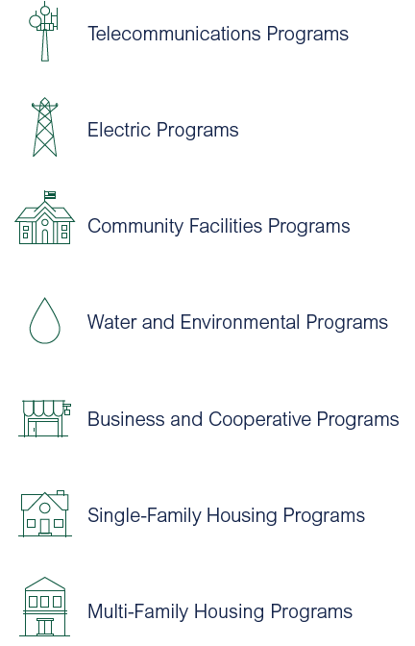
USDA Rural Development
USDA Rural Development is the lead Federal agency helping rural communities grow and prosper
We have more than 40 programs to support rural America and Invest more than $28 billion in loans, grants and guarantees each year.
USDA Rural Utilities Service
Chad Rupe, Administrator
(202) 720-9540
chad.rupe@usda.gov
www.rd.usda.gov
Notes:
We offer many services to finance the construction of critical infrastructure including telecom and electric utilities.

Slide 5
Rural Development Offices
Rural Development
Rural Housing Service
Rural Business Cooperative Service
Rural Utilities Service
Notes:
At the national level, our programs and services are delivered through three agencies.
We have over $200 billion in loans and generate over $28 billion in loan and grants annually to rural America.

Slide 6
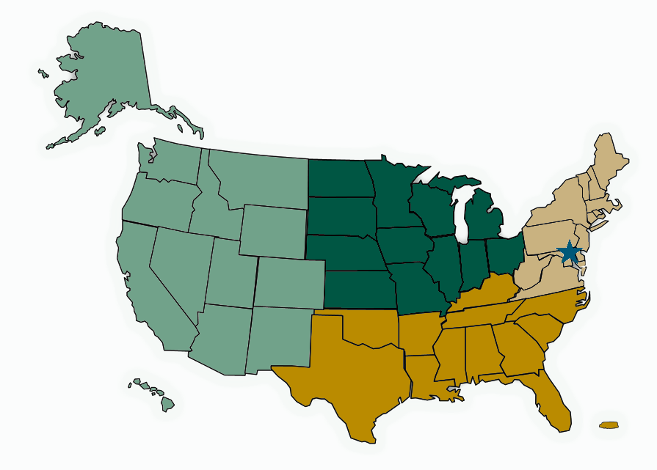
Rural Development Offices
4 Regions
47 State Offices
400 Area Offices
1 National Office in DC
Notes:
We are one of the few federal agencies that have deep reach into rural America, where the greatest share of Americans lack broadband.

Slide 7










Chad Rupe
Administrator
Curtis Anderson
Chief of Staff
Carolyn Roddy
Strategic Policy Advisor
Taylre Beaty
Policy Coordinator and Assistant to the Administrator
Electric Program
Christopher McLean
Assistant Administrator
Telecommunications Program
Laurel Leverrier
Assistant Administrator
Water and Environmental Programs
Edna Primrose
Assistant Administrator
Office of Operations -- Laurel Leverrier, Dep. Ass’t Admin.
Office of Operations -- Jim Elliott, Dep. Ass’t Admin.
Portfolio Management and Risk Assessment -- Victor Vu, Dep. Ass’t Admin.
Loan Origination and Approval -- Joseph Badin, Dep. Ass’t Admin.
Loan Origination and Approval -- Shawn Arner, Dep. Ass’t Admin
Portfolio Management and Risk Assessment -- Peter Aimable, Dep. Ass’t Admin
Policy and Outreach -- Ken Kuchno, Dep. Ass’t Admin
Deputy Assistant Administrator -- Scott Barringer
Customer Service & Technical Assistance -- Gerard Moore, Dep. Ass’t Admin.
Environmental and Engineering Staff, Director Barbara Britton
Director, Water Program Division, Hal Nielson
General Field Representatives
General Field Representatives
State and Regional Staff
Notes:
Rural Utilities Service is focused on three types of utilities.

Slide 8
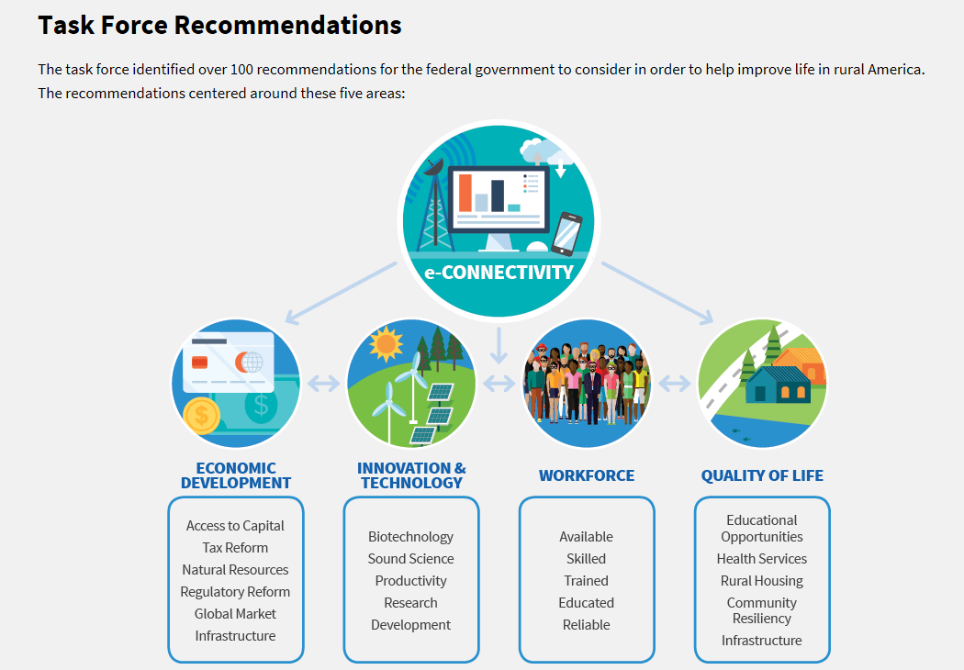
Interagency Task Force on Agriculture and Rural Prosperity
Notes:
USDA and RUS is uniquely positioned to support economic growth in rural America through financing construction of infrastructure with loans and grants. It is the basis for bridging the digital divide.

Slide 9
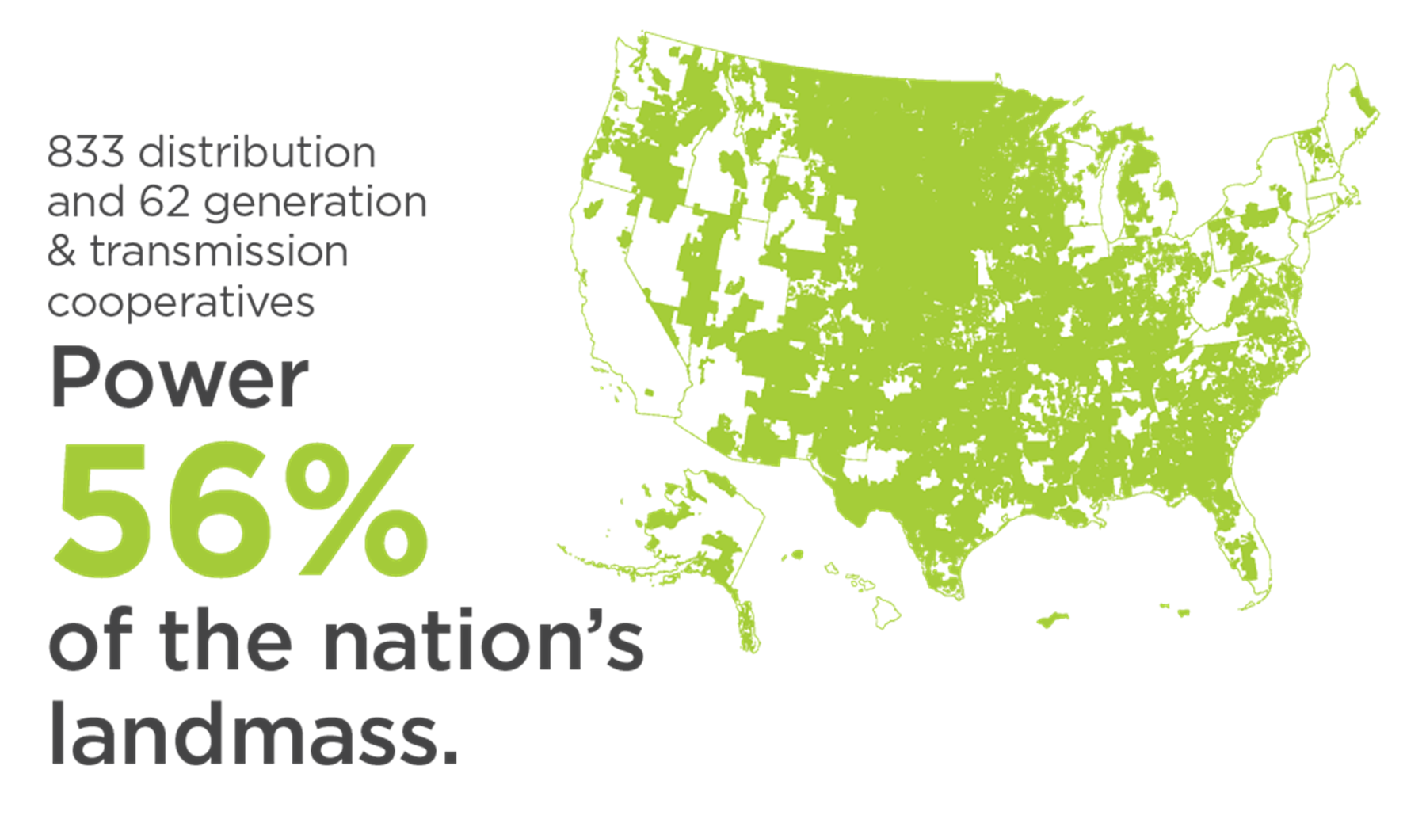
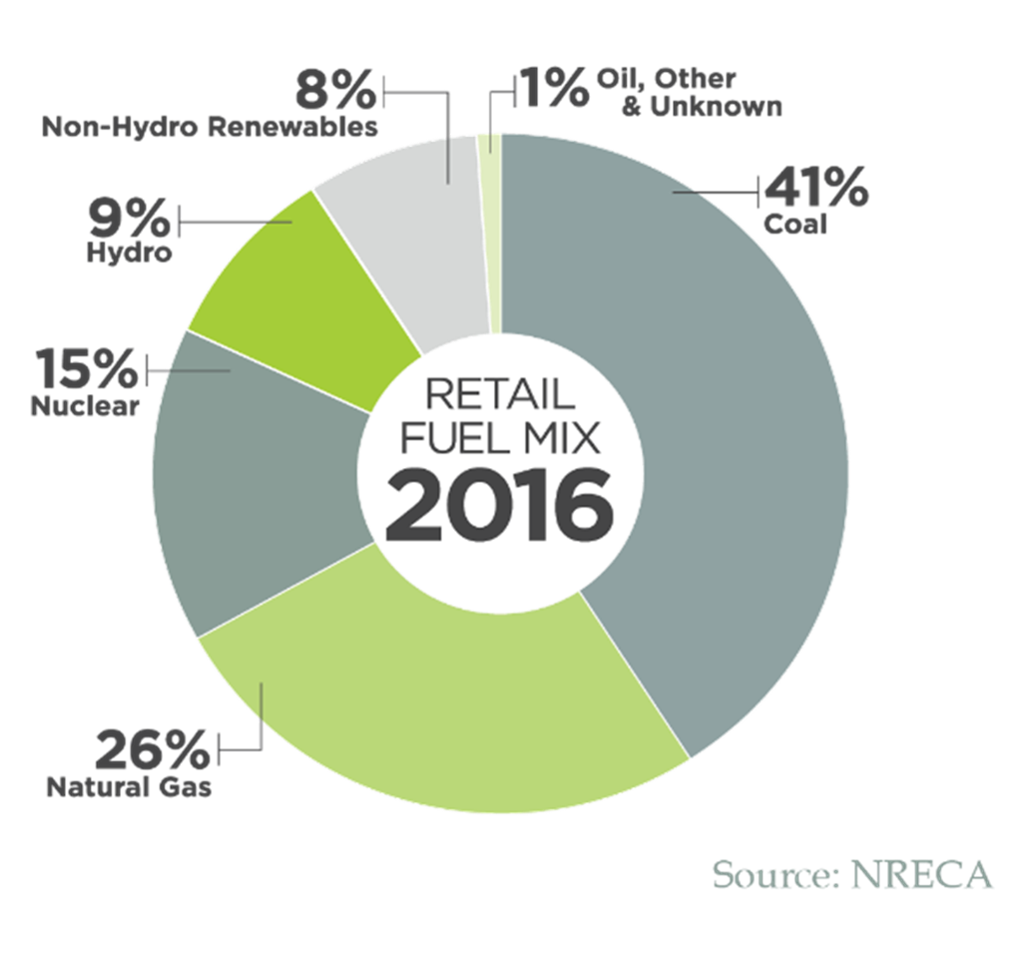
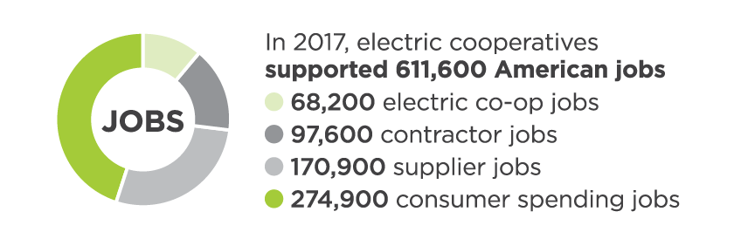
Typical RUS Electric Borrowers
Notes:
This map shows the reach of the 895 electric cooperatives in the U.S., and jobs they support. Our Electric portfolio has many of these cooperatives either in their portfolio now, or were borrowers within the last 80 years. They have a unique capacity to solve the middle mile problem due to the vast electric transmission and distribution infrastructure they build and maintain throughout rural America.

Slide 10
RUS Electric Infrastructure Loans – Historical Perspective
Provide loans to nonprofit and cooperative associations, public bodies, and other utilities
576 electric borrowers serving 42 states to 42 million consumers, plus 13 Rural Energy Savings Program borrowers and two financial institutions that we fund for financing electric utilities.
Funds may be used to finance: Maintenance, Upgrades, Expansion, Replacement of distribution,
sub-transmission and headquarters (service, warehouse) facilities, Energy efficiency, Renewable energy systems
$44 Billion existing loan portfolio with negative subsidy rate
Notes:
With this portfolio we reach into 42 states to continue to upgrade and build new generation, transmission, and distribution lines. This includes smart grid technology with fiber optics.

Slide 11
RUS Electric Budget Program ($ billion)
(As of March 19, 2020)
 | FY16 Obligations | FY17 Obligations | FY18 Obligations | FY19 Obligations | FY20 Program Level | FY20 YTD Obligations
Electric Infrastructure Loans Programs | 3.4 | 4.1 | 3.9 | 5.7 | 6.25 | 0.9
Notes:
Annually we loan between 3 and 6 billion dollars in our electric infrastructure loan program at long term very low fixed rates. Most of our awards are made in the second ½ of the fiscal year.

Slide 12
RUS Telecom Program Overview
 | Funding Type | Program Purpose | Rural Area Limit
Telecommunications Infrastructure Program | Loans | Construction, maintenance, improvement and expansion of telephone and broadband service, and refinancing of debt | 5,000 or less
Rural Broadband Program | Loans, Loan/Grants and Loan Guarantees | Construction, maintenance, improvement and expansion of broadband service, and refinancing of debt | 20,000 or less for loans and grants; and 50,000 or less for loan guarantees
Community Connect | Grants with 15% match | Construction and expansion of broadband service | 20,000 or less
Distance Learning and Telemedicine (DLT) | Grants with 15% match | Equipment to deliver telemedicine service and distance learning curriculums | 20,000 or less
ReConnect Program | Loans, Loan/Grants and Grants with 25% match | Construction, improvement and expansion of broadband service | 20,000 or less
Notes:
Our telecom program has several grant and loan programs to bridge the digital divide and each program serves different purposes and have evolved over different periods of time in the last 70 years.

Slide 13
RUS Telecom Program Requirements
 | Unserved Requirement | Unserved Broadband Speed Threshold | Broadband Buildout Requirement | Public Notice Filing Requirement | Application Submission
Telecommunications Infrastructure Program | Cannot duplicate existing voice service | N/A | N/A | To Be Implemented in Fiscal Year 2020 | RD Apply
Rural Broadband Program | 50% for loans and loan guarantees and 90% for loan/grants | 25 Mbps download and 3 Mbps upload | 25 Mbps download and 3 Mbps upload | Yes, existing requirement | RD Apply
Community Connect | 100% | 10 Mbps download and 1 Mbps upload | 25 Mbps download and 3 Mbps upload | To Be Implemented in Fiscal Year 2020 | Paper Applications
Distance Learning and Telemedicine (DLT) | N/A | N/A | N/A | N/A | Paper Applications
ReConnect Program | 90% | 10 Mbps download and 1 Mbps upload | 25 Mbps download and 3 Mbps upload | Yes, existing requirement | SalesForce
Notes:
The ReConnect program is the most popular program currently, but each of the other programs have their own strengths that can help solve issues where others are restricted.

Slide 14
RUS Telecom Program Budget ($ millions)
(As of March 19, 2020)
 | FY16 Obligations | FY17 Obligations | FY18 Obligations | FY19 Obligations | FY20 YTD Obligations
Telecommunications Infrastructure Program | 191 | 411 | 162 | 181 | 66
Rural Broadband Program | 4 | 26 | 22 | 37 | 9
Community Connect | 12 | 25 | 44 | 18 | 8
Distance Learning and Telemedicine (DLT) Program | 21 | 21 | 45 | 46
ReConnect Program |  |  |  | 7 | 744
Notes:
As you can see, the ReConnect program is creating a unique opportunity with the level of grants that when matched with loans, allow both telecom and electric providers to solve the last mile problems to reach the unserved.

Slide 15

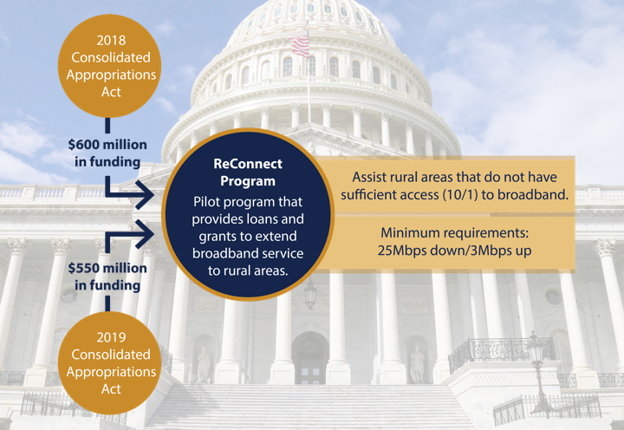
2020
Further Consolidated Appropriations
Act
$555 million in funding
Notes:
Congress has continued to offer appropriations to solve this issue. The $751 million we leveraged in the previous slide was based on the first $600 million. We have the second funding opportunity currently open and have full capacity to award the remaining funding for quality applications as needed.

Slide 16
Smart Grid and Middle Mile Solutions
Section 6210 (2018 Farm Bill) Smart Utility Authority for Broadband
  (1) The Secretary (of Agriculture) may allow a recipient of a grant, loan, or loan guarantee provided by the Office of Rural Development under this title (7USC 1981) to use not more than 10% of the amount so provided –
  (A) for any activity for which assistance may be provided under Section 601 of the Rural Electrification Act of 1936; or
  (B) to construct other broadband infrastructure
  (2) Paragraph (1) of this subsection shall not provide funding under paragraph (1) if the funding would result in competitive harm to any grant, loan, or loan guarantee provided under the Rural Electrification Act of 1936.
  A recipient who sets aside fund under this subsection may use the funds only in an area that is not being provided with the minimum acceptable level of broadband service established under section 601(e), unless the recipient meets the requirements of section 601 (d).
Notes:
With new authority from the 2018 Farm Bill, any loan or grant provided by USDA Rural Development may allow up to 10% of the award to be used for broadband infrastructure.
However, there are restrictions to prevent overbuild for those who receive minimum acceptable level of broadband service, which the FCC currently defines as 25/3.

Slide 17
Public Notice, Assessments, and Reporting Requirements
Section 701
The Secretary (of Agriculture) shall promptly make available to the public, a fully searchable database on the website of the Rural Utilities Service that contains information on all retail broadband projects provided assistance or for which assistance is sought that are administered by the Secretary, including, at a minimum:
  Applicant ID
  Description of project
  Map of proposed service area
  Status of application
  Estimated number and proportion of service points without fixed broadband service
  Notice of each entity receiving USDA broadband assistance in the area, along with its annual report that is submitted (redact as needed to protect any proprietary information)
  45 day public challenge period to any retail broadband proposed service area receiving USDA funds
  Conduct site specific testing to verify unavailability of any retail broadband service.
Notes:
With all broadband related loans and grants, USDA is required to post the pertinent facts of the request to serve an area on a publicly available site and allow for 45 days any provider to challenge the application.
USDA is required to conduct site specific testing to determine the validity of the application and the validity of the challenge.

Slide 18

End Slide
USDA is an equal opportunity provider, employer, and lender.
Notes:
The bottom line to my message is that when providers work in concert rather than as adversaries, problems of the digital divide get answered more quickly and that cooperation helps immediate and long term economic growth throughout rural America. It is a fact that when rural America thrives, all of America thrives, and Together, America Prospers.

