Slide 1
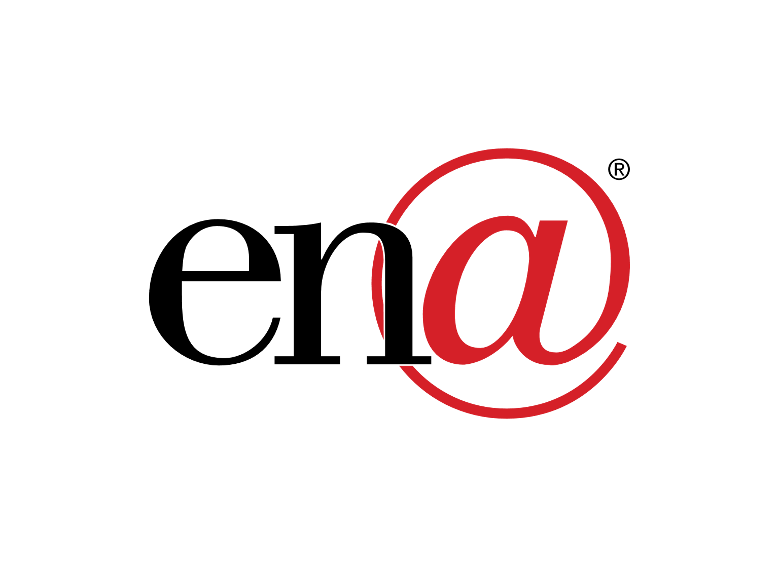
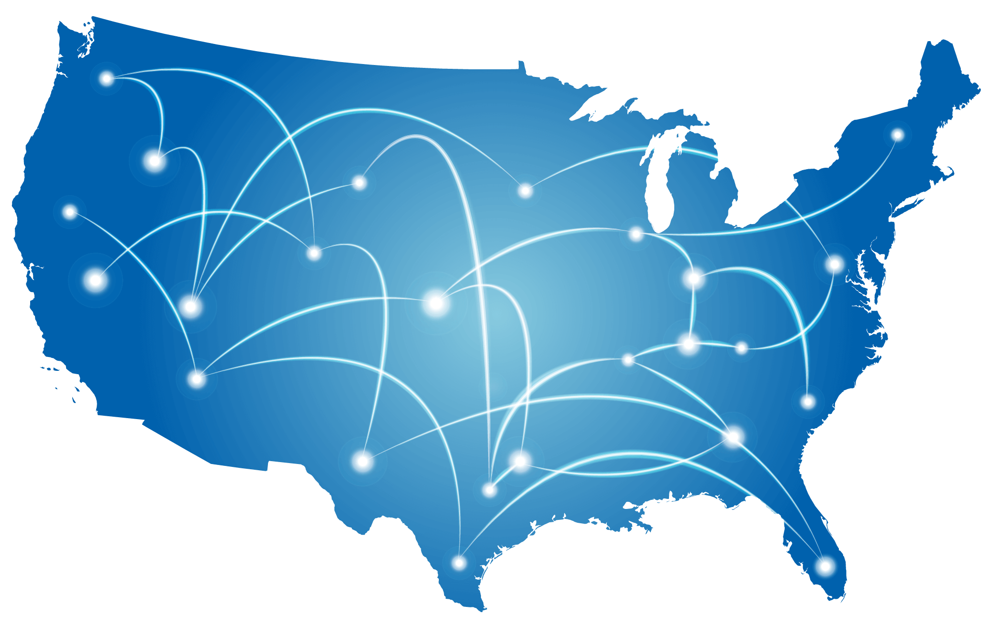
ONE
out of every
12
Across America we are serving
public school students are served by one or more of our transformative technology solutions
8000+
685+
School Districts
410+
Cities and
Libraries
800+
Healthcare Facilities
community anchor institutions

Slide 2
Western Governors’ Association Webinar
April 15th, 2020

Slide 3
Network Strategy
Underserved Markets
Dark Fiber
Fatbeam’ strategic focus is on markets underserved by traditional telecommunications carriers and fiber optic network providers, predominantly those with between 5,000 and 150,000 in population.
The Company performs substantial due diligence before entering a new market and utilizes an anchor tenant strategy to finance and build networks that connect to key nearby data centers and long-haul networks as well as facilitate substantial near-net opportunities upon completion.
In most cases, Fatbeam’s anchor client within a new market will be a school district, with network services provided under the guidelines of the federal government’s E-rate program.
Once Fatbeam has delivered services to the SD, we build in additional fiber at our own expense to then expand into the community and bring 1G DIA. This in turn helps increase the economic development and create competitive pricing within the community.
High Fiber Count
Ownership Retention
Anchor Tenant
Interconnection With Key Infrastructure
Due Diligence
Route Diversity

Slide 4
Who We Are
Fatbeam At-a-Glance
Fatbeam was established in June 2010 by Greg Green, who brings over 20 years of management experience within the telecommunications sector with firms such as NEXTLINK, Avista and OneEighty; and Shawn Swanby, a veteran from the education technology sector across the Northwest U.S.
Fatbeam, LLC operates as an open access provider delivering high-bandwidth connectivity solutions to education, carrier, government and enterprise customers across the Western United States.
Fatbeam owns and operates a fiber optic backbone on diverse routes from other regional operators spanning 400+ route miles and over 45,000 fiber miles and extending into 40 markets in Idaho, Montana, Oregon, Nevada, Arizona, Washington, and Wyoming.
The Company’s service portfolio includes WAN and DIA services , with speeds starting at 1G and scaling to unlimited access.
Founded: | 2010
Employees: | 34
Service Offering: | Dark Fiber Lit Fiber 1Gig Internet
Markets: | Western United States
Customers: | Education Carrier Enterprise Healthcare Government
Network: | 400+ route miles 45,000+ fiber miles

Slide 5
Case Study Sunnyside School District
The Challenge
The Sunnyside School District was having diﬃculty connecting Outlook Elementary, a satellite school on the outskirts of town. Supporting this school was extremely diﬃcult as their network connection was a fractional T1, with a total bandwidth of about 3 megabits.
The Solution
Fatbeam connected Outlook Elementary to Sunnyside School Districts entire ﬁber network and currently provides the district with a Dark Fiber WAN and a 2G internet connection. In addition, Fatbeam’s customer service which provides a dedicated representative to the district is extremely responsive, whenever Sunnyside needs assistance Fatbeam will address their needs immediately.
The Results
Sunnyside School Districts bandwidth has increased significantly and costs have decreased by roughly 30%

Slide 6
Case Study Coeur d’Alene School District
The Challenge
As the population of Coeur d’Alene has grown, so have the needs of their school district. Students have been moving in from all over the country requiring the school district to build new schools and expand their existing network. The district went from being a “3 students per device school” in 2014 to a “one student per device school” in 2019.
The Solution
Fatbeam increased the Coeur d’Alene School District’s bandwidth by providing them with a Dark Fiber WAN and (2) 10G internet connections. Fatbeam has connected all 24 sites covering 29 square miles.
The Results
Now the Coeur d’Alene School District has zero lag time, no longer faces the bandwidth restrictions that once plagued their network and has reduced costs by roughly 40%.

